Slide 1

Pursuing a CS PhD in Europe and Germany
Talk 2: PhD Life and Beyond
Dr. Bijun Li
July 2024

Slide 2

Overview of Talk 2
Funding and Financial Planning
Starting Your PhD and Research Life
Publishing and Conferences
Challenges and Professional Development
Completing Your PhD
Career Prospects Post-PhD

Slide 3
Funding and Financial Planning
Types of Funding
University contract (wissenschaftlicher Mitarbeiter):
TV-L E13 100%: gross 4600€, net 2800€
TV-L E13 50%: gross 2300€, net 1500€
Scholarships (e.g., CSC, DAAD, DFG)
Industry-sponsored PhDs
Living Costs (per month)
Vary by city (e.g., Munich vs. Leipzig)
Rent: 400-500€ single room, 600-800€ apartment
Food (200-300€), insurance (30€), transportation (50€), mobile contract (30€), registration fee (400€ per semester) etc.
Scholarship vs. Contract
Scholarship: Tax-free, no social insurance
Contract: Taxed, includes benefits
Budgeting Tips
Use student discounts
Plan for conference travel

Slide 4
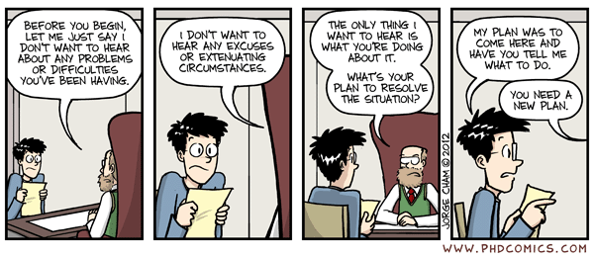
Starting Your PhD
Arrival and Settlement
Finding accommodation (university housing, WGs)
Administrative tasks (Anmeldung, bank account, resident permit)
Health insurance (public vs. private)
Developing Your Research Plan
Conduct thorough literature review
Define clear research questions
Select appropriate methodologies
Set realistic milestones
Integration into Research Group
Attend orientation programs
Meet colleagues and supervisors
Understand lab protocols and resources

Slide 5
PhD Life and Research
Structuring Your Research
Set milestones and deadlines
Regular supervisor meetings
Balance research and other duties
Teaching and Supervision
Teaching assistant duties
Supervise bachelor’s/master’s theses
Develop pedagogical skills
Collaboration Opportunities
Within your research group
Interdisciplinary projects
International collaborations
Work-Life Balance
Manage time effectively
Engage in non-academic activities
Utilize university sports/language center

Slide 6
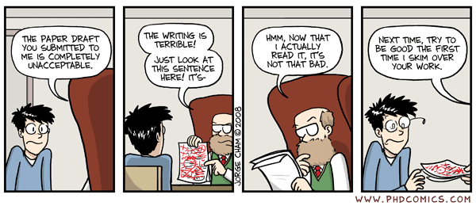
Publishing and Conferences
Importance of Publications in CS
Conference papers often valued over journals
Build your research profile
Choosing the Right Venues
Top conferences (acceptance rate < 15%, ACM, USENIX, IEEE)
Relevant workshops for early-stage research
Writing and Submission Process
Use collaborative writing tools (git)
Understand peer review process
Handle revisions and rejections constructively

Slide 7
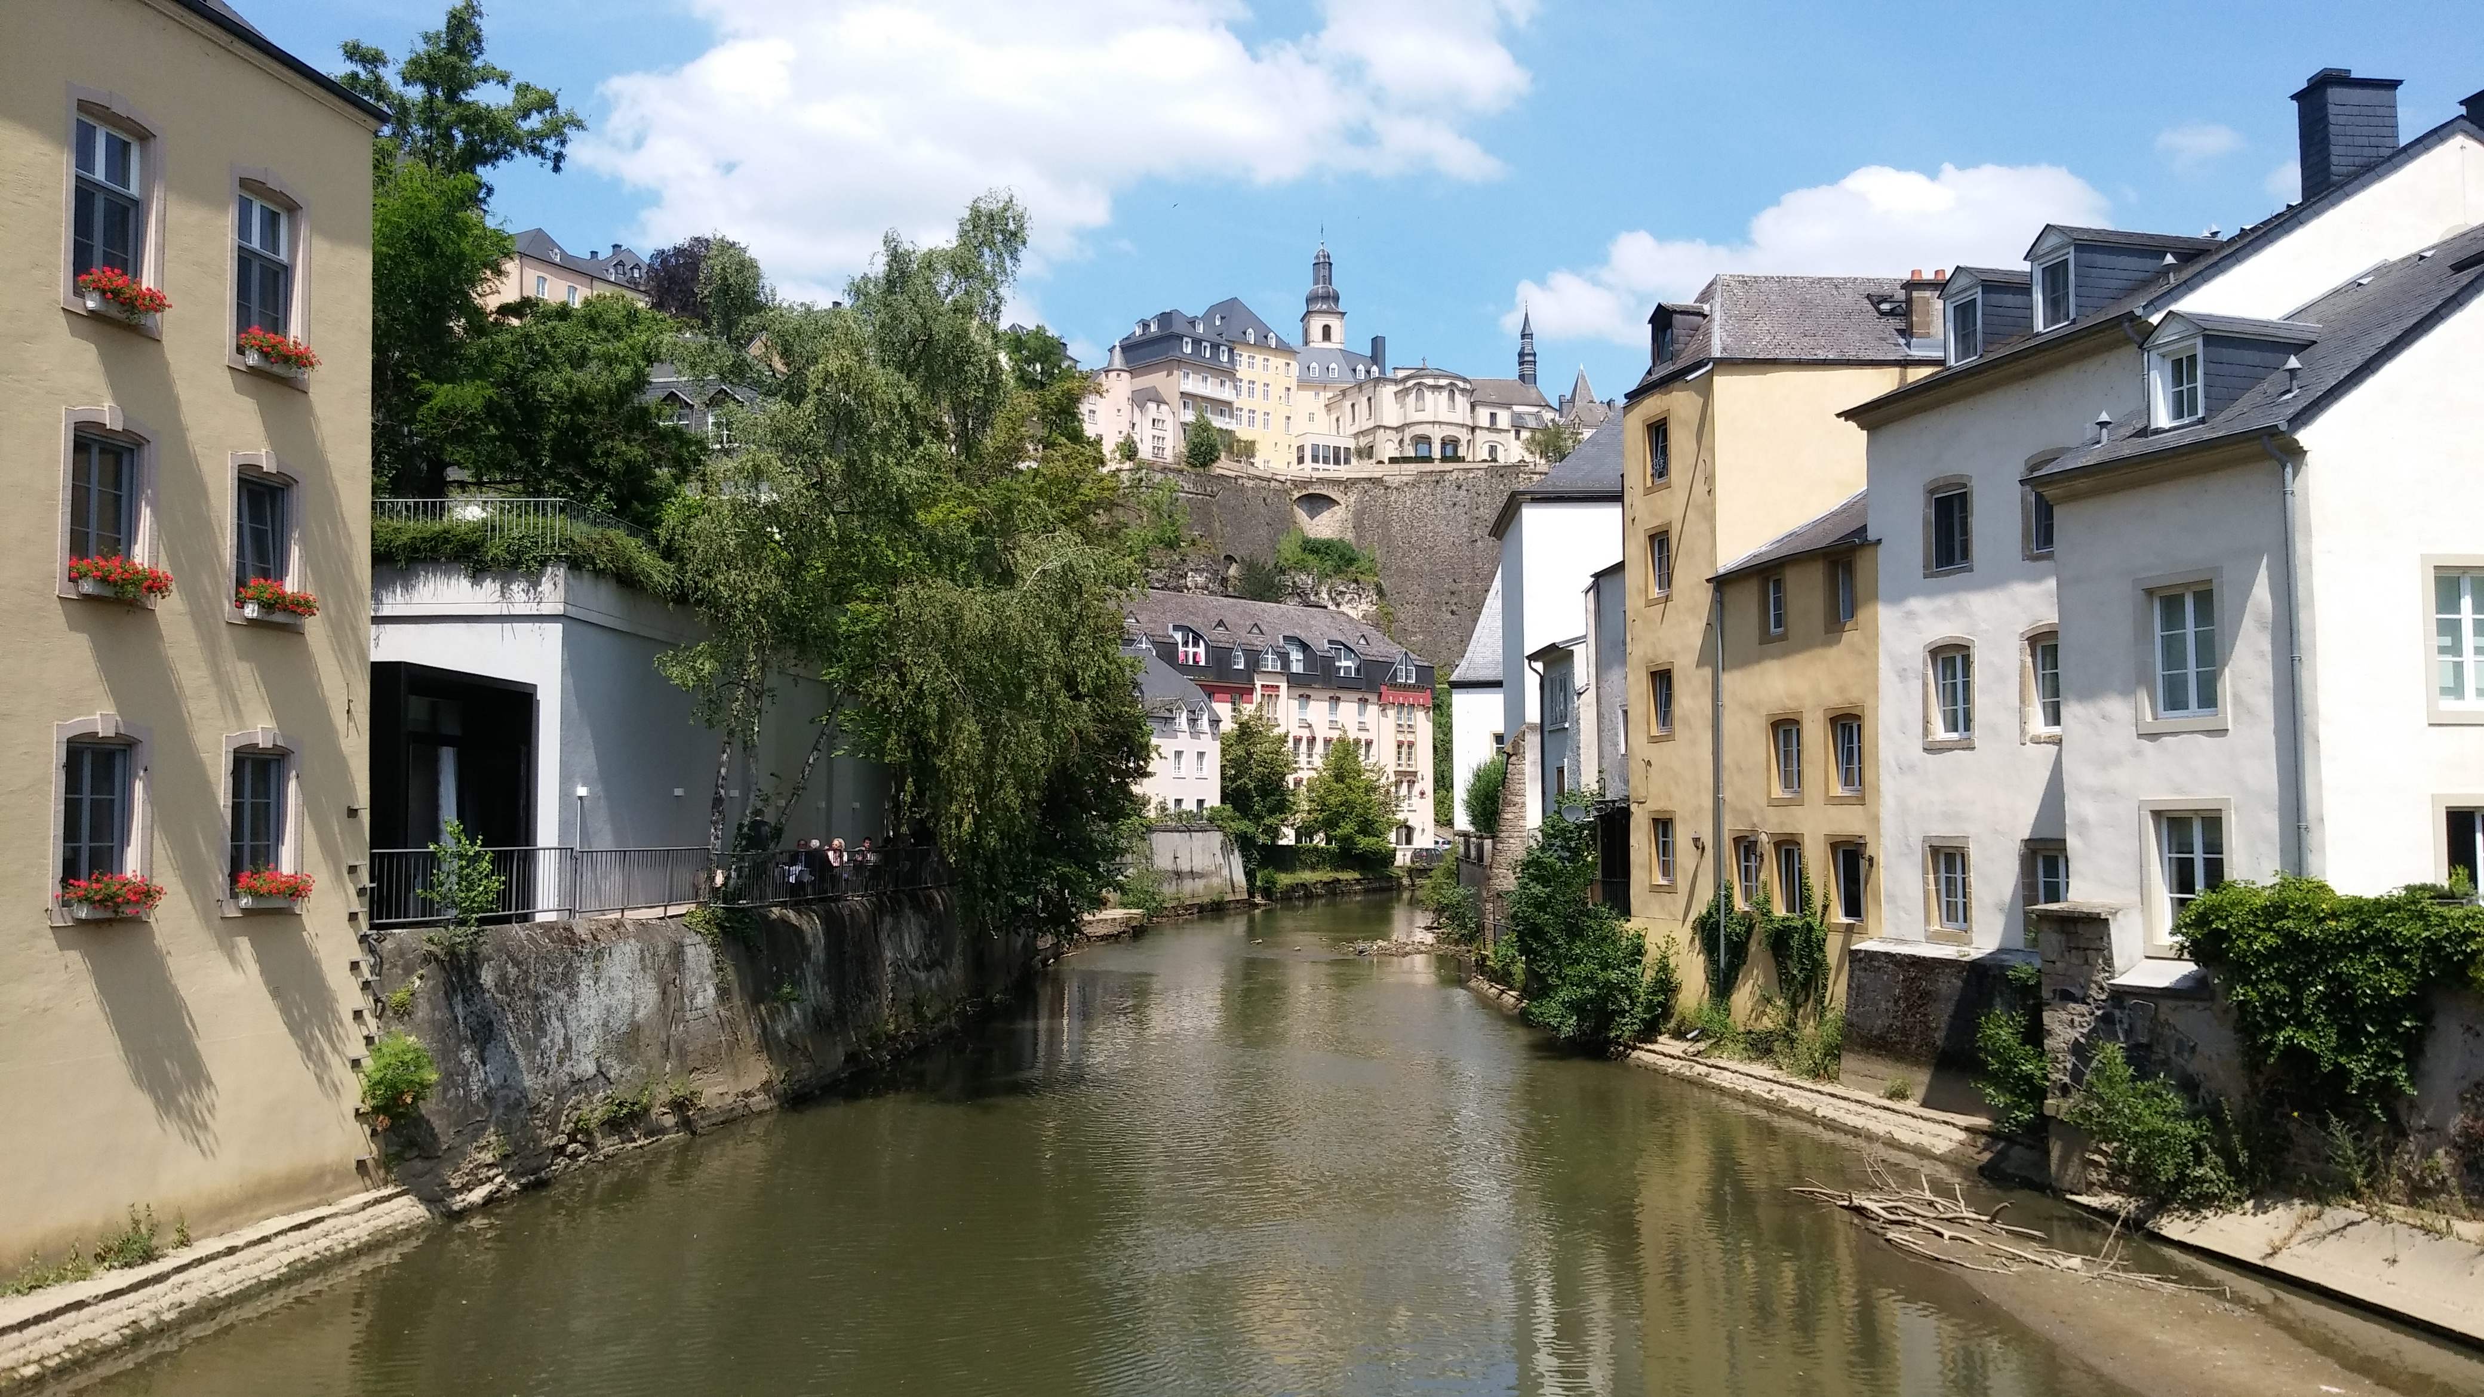
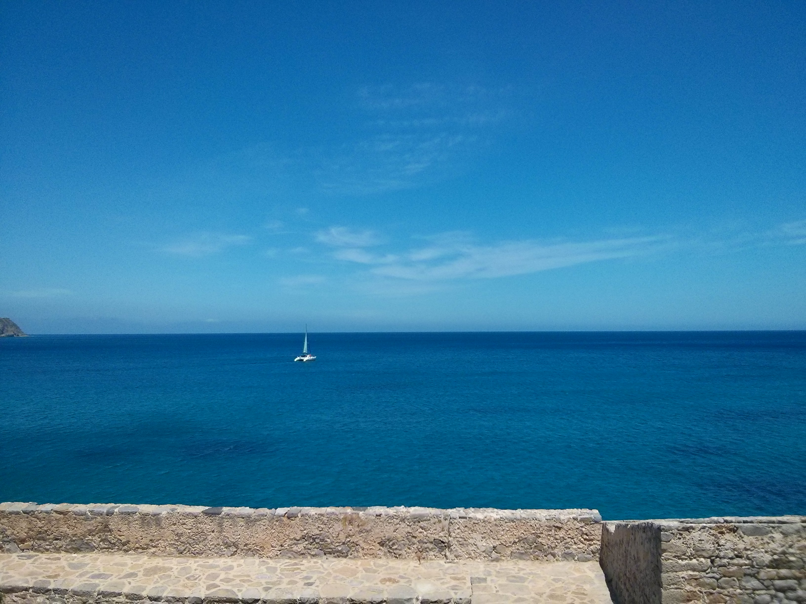
Publishing and Conferences
Presenting at Conferences
Prepare effective presentations
Network with other researchers
Gain visibility in your field
DSN’18,
Luxemburg
Enjoy conference travel
Local food and conference banquet
Conference event
Additional stay at own cost
DAIS’16,
Crete, Greece

Slide 8
Challenges and Professional Development
Professional Development
Enhance technical skills
Develop soft skills (communication, leadership)
Explore internship opportunities
Common Challenges
Research setbacks
Work-life balance
Cultural adaptation
Overcoming Challenges
Seek support (supervisor, peers)
Practice self-care and mindfulness
Networking
Attend workshops on research skills
Join professional associations
Utilize online platforms (LinkedIn, ResearchGate)

Slide 9
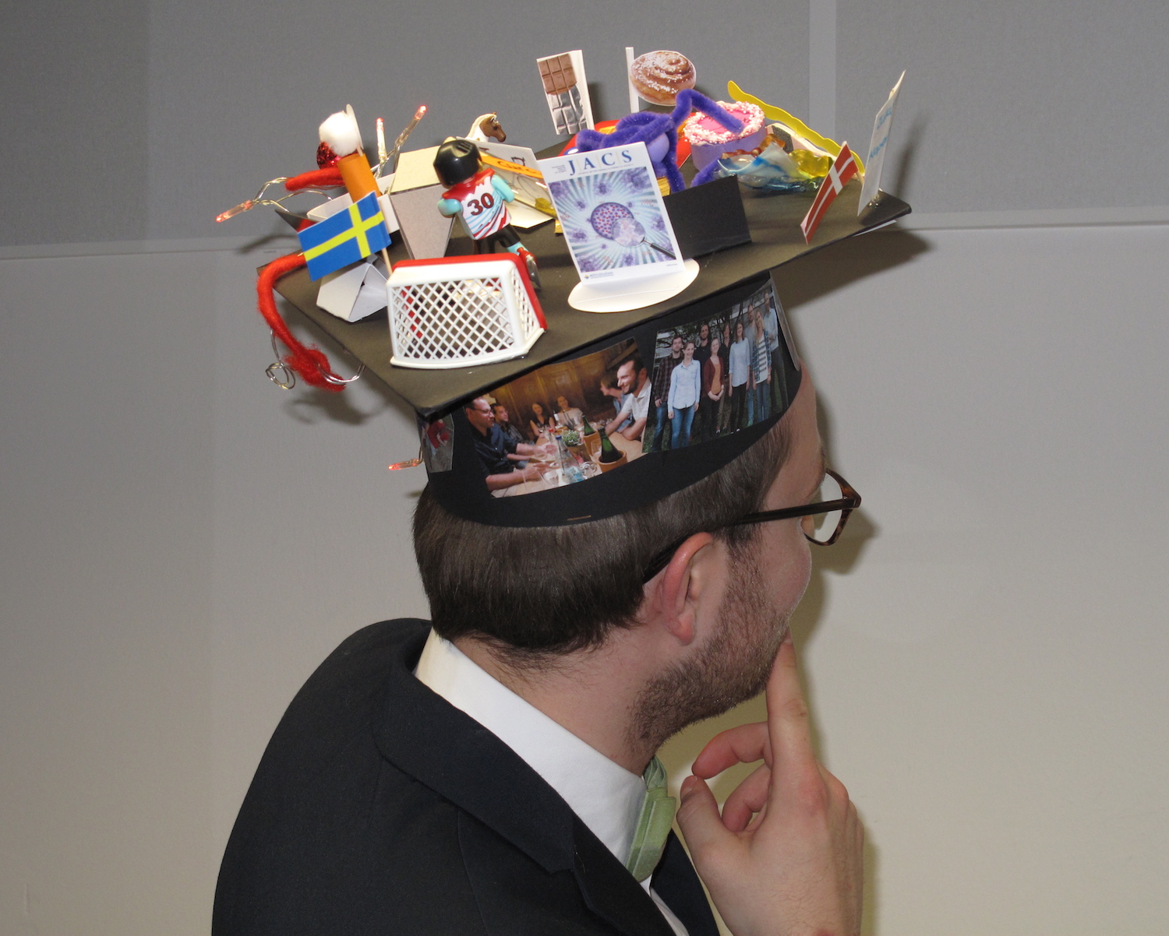
Completing Your PhD
Timelines
Average duration: 3-5 years
Extensions possible if needed
Thesis Writing Process
Start early, write continuously
Follow university guidelines
Seek feedback regularly
Publication Requirements
Vary by university and department
Often 3-4 conference papers or 1-2 journal articles
Submission and Defense
Understand submission requirements
Prepare for oral defense (disputation)
Typical duration: 60-90 minutes

Slide 10
Career Prospects Post-PhD
Academic Paths
Postdoctoral positions
Junior professorships
Research group leaders
Industry Opportunities
R&D roles in tech companies
Data science positions
AI/ML specialists
Research Positions
Government research institutes
Industrial research labs
Think tanks and consultancies
Entrepreneurship
Tech startups
University spin-offs
Consulting services

Slide 11
Conclusion
Key Takeaways
Plan finances carefully
Embrace the research journey
Publish and present your work
Develop a strong professional network
Prepare for diverse career paths
Final Advice
Stay curious and passionate about your research
Be open to interdisciplinary collaborations
Embrace challenges as growth opportunities
Maintain a healthy work-life balance

Slide 12
Q&A Session
Time for Your Questions!
Don’t hesitate to ask about any aspect of applying for a CS
PhD in Germany.
Your questions help everyone learn!

